Slide 1
Transposons
linked to a higher HGT rate, propagating
carry
Defense mechanism
cassettes
Increased genome size
spreads
helps competion
and defense on
correlates with
Particle-associated lifestyle
A deep-ocean microbial community

Slide 2
Transposons
buffers distruptive
transpositions
caused by
carry
Defense mechanism
cassettes
spreads
Increased genome size
helps competion
and defense on
correlates with
Particle-associated lifestyle
A deep-ocean microbial community

Slide 3
particle-associated cassettes
- Defense mechanisms
- Signal Transduction mechanisms
- Extracellular Structures
- Cell motility
benefit the host and help the host compete in
carry
particle-associated lifestyle
transposons
spreads
linked to a higher
HGT rate, propagating
correlates with
increased genome size
A deep-ocean microbial community

Slide 4
transposons
buffers distruptive
transpositions
caused by
Defense mechanisms
Signal Transduction mechanisms
Cell motility
Extracellular Structures
carry
Particle-associated
cassettes
Increased genome size
spreads
correlates with
Particle-associated lifestyle
helps competion
and defense on
A deep-ocean microbial community

Slide 5
Transposons
buffer distruptive
transpositions
caused by
carry
Defense mechanism
cassettes
Increased genome size
spreads
helps competion
and defense on
correlates with
Particle-associated lifestyle
A deep-ocean microbial community

Slide 6
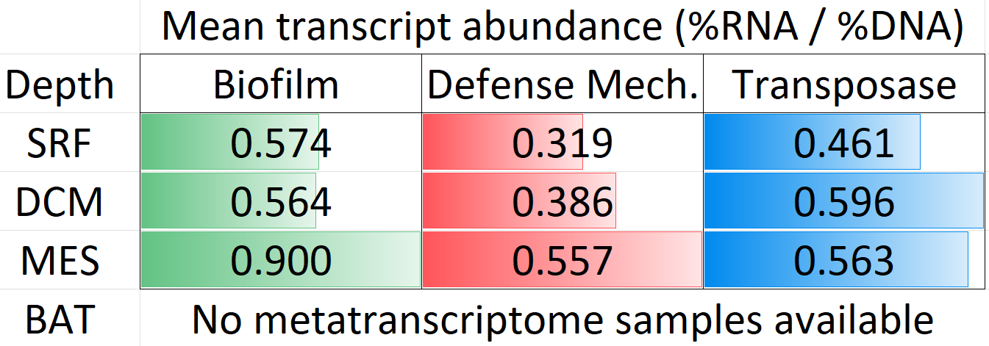
ns
]
**
***
]
]

Slide 7
Transposons
spreads
carry
helps competion and defense on
The switch to particle lifestyle
Defense
mechanism
cassettes
A deep-ocean microbial community

Slide 8
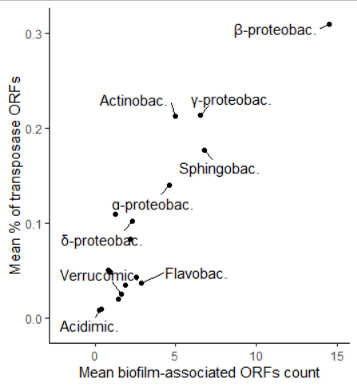
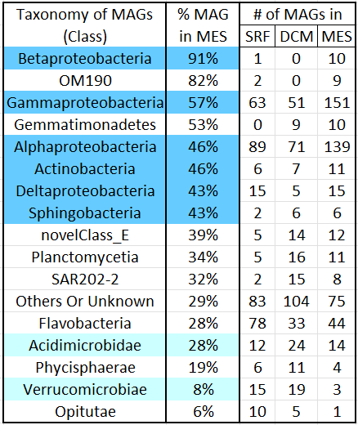
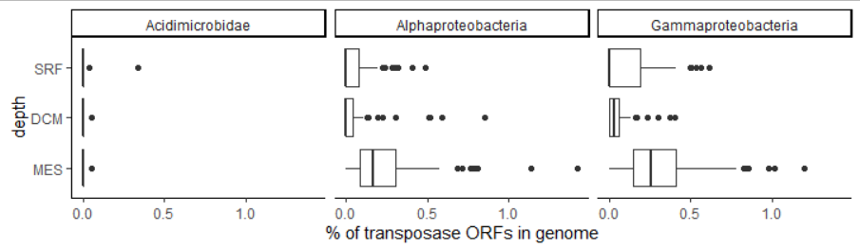








Slide 9
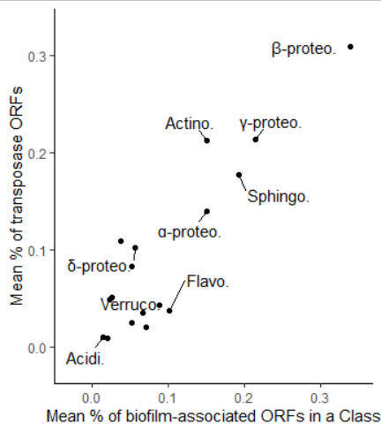




Slide 10
